Slide 1

Compiler Construction
Muhammad awais ali
Department of Computer Science
University of Management & technology

Slide 2
Syntax Analyzer
Syntax analyzer is a second phase of the compiler design that comes after lexical analyzer.
It analyses the syntactical structure of the given input.
It checks if the given input is in the correct syntax of the programming language in which the input which has been written.
It is also knows as parse tree.

Slide 3
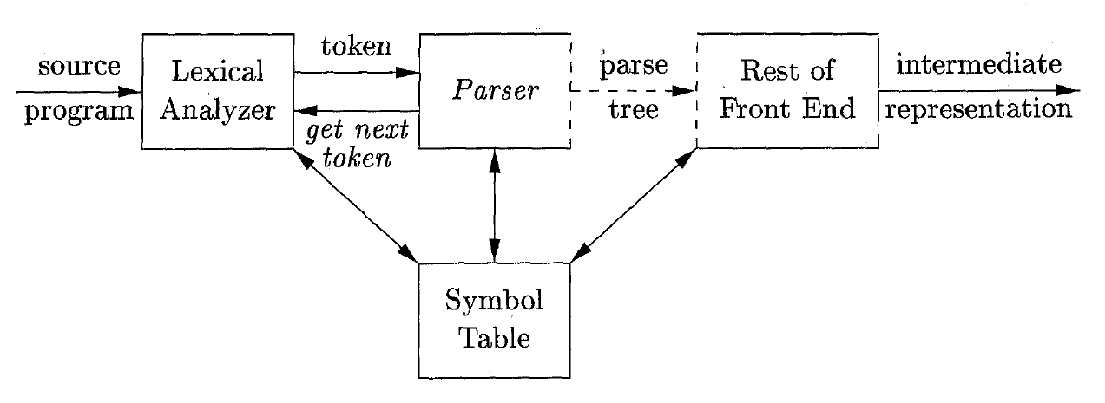
Role of the Parser
In our compiler model, the parser obtains a string of tokens from the lexical analyzer, and verifies that the string of token names can be generated by the grammar for the source language.

Slide 4
Role of the Parser
There are three general types of parsers for grammars: universal, top-down, and bottom-up.
Universal parsing methods such as the Cocke-Younger-Kasami algorithm and Earley's algorithm can parse any grammar. These general methods are, however, too inefficient to use in production compilers.
The methods commonly used in compilers can be classified as being either top-down or bottom-up.
Top-down methods build parse trees from the top (root) to the bottom (leaves), while bottom-up methods start from the leaves and work their way up to the root.

Slide 5
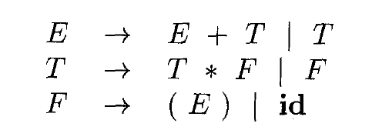
Representative Grammars
E represents expressions consisting of terms separated by + signs
T represents terms consisting of factors separated by * signs
F represents factors that can be either parenthesized expressions or identifiers

Slide 6
Syntax Error Handling
Lexical errors include misspellings of identifiers, keywords, or operators - e.g., the use of an identifier elipsesize instead of ellipsesize – and missing quotes around text intended as a string.
Semantic errors include type mismatches between operators and operands.
Syntactic errors include misplaced semicolons or extra or missing braces; that is, '((" or ").“
Logical errors can be anything from incorrect reasoning on the part of the programmer to the use in a C program of the assignment operator = instead of the comparison operator ==

Slide 7
Error-Recovery Strategies
Once an error is detected, how should the parser recover?
Panic-Mode Recovery
The parser discards input symbols one at a time until one of a designated set of synchronizing tokens is found. The synchronizing tokens are usually delimiters, such as semicolon or }
Phrase-Level Recovery:
A typical local correction is to replace a comma by a semicolon, delete an extraneous semicolon, or insert a missing semicolon. Its major drawback is the difficulty it has in coping with situations in which the actual error has occurred before the point of detection.

Slide 8
Context-Free Grammar
Grammars describe the syntax of programming language constructs like expressions and statements.
stmt -> if ( expr ) stmt else stmt
Syntactic variable stmt to denote statements and variable expr to denote expressions, the production specifies the structure of this form of conditional statement.
A language generated by a (context-free) grammar is called context free language.

Slide 9
Formal Definition of a Context-Free Grammar
Context-free grammar (grammar for short) consists of terminals, nonterminals, a start symbol, and productions.
Terminals:
Terminals are the basic symbols from which strings are formed. Terminals describes a finite set of terminal symbols. The terminals are the keywords if and else and the symbols "(" and ") .“
NonTerminals:
Nonterminals are syntactic variables that denote sets of strings. stmt and expr are nonterminals. The sets of strings denoted by nonterminals help define the language generated by the grammar.

Slide 10
Formal Definition of a Context-Free Grammar
Start Symbol
In a grammar, one nonterminal is distinguished as the start symbol, and the set of strings it denotes is the language generated by the grammar.
Productions
The productions of a grammar specify the manner in which the terminals and nonterminals can be combined to form strings.
Each production consists of:
A nonterminal called the head or left side of the production; this production defines some of the strings denoted by the head.
The symbol -> Sometimes : : = has been used in place of the arrow.
A body or right side consisting of zero or more terminals and nonterminals.

Slide 11
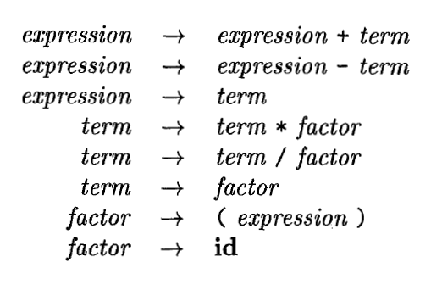
Formal Definition of a Context-Free Grammar
In this grammar, the terminal symbols are id, +, -, *, /. ( )
The nonterminal symbols are expression, term and factor, and expression is the start symbol.

Slide 12
Notational Conventions
To avoid always having to state that "these are the terminals," "these are the nontermiaals ," and so on, the following notational conventions for grammars
will be used throughout the remainder of this book.
These symbols are terminals:
(a) Lowercase letters early in the alphabet, such as a, b, e.
(b) Operator symbols such as +, r, and so on.
(c) Punctuation symbols such as parentheses, comma, and so on.
(d) The digits 0,1,. . . ,9.
(e) Boldface strings such as id or if, each of which represents a single terminal symbol.

Slide 13
Notational Conventions
These symbols are nonterminals:
Uppercase letters early in the alphabet, such as A, B, C.
The letter S, which, when it appears, is usually the start symbol.
Lowercase, italic names such as expr or stmt.
When discussing programming constructs, uppercase letters may be used to represent nonterminals for the constructs. For example, nonterminals for expressions, terms, and factors are often represented by E, T, and F, respectively.
Uppercase letters late in the alphabet, such as X, Y, Z, represent grammar symbols; that is, either nonterminals or terminals.
Lowercase letters late in the alphabet, chiefly u, v, ... , x, represent strings of terminals.

Slide 14
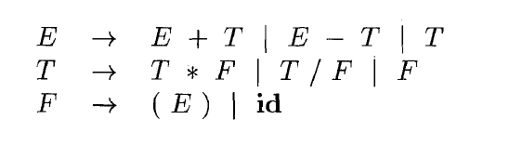
Notational Conventions
A set of productions A -> a1, A -> a2, . . . , A -> ak with a common head. A (call them A-productions), may be written A -> a1 | a2 | . . | ak. Call a1, a2,. . . , ak the alternatives for A.
Unless stated otherwise, the head of the first production is the start symbol.
The notational conventions grammar of previous example can be rewritten as

Slide 15
Derivations
Assume we have a production A -> α, we would then say that A derives α and write A ⇒ α
We generalize this, if, in addition β and γ are strings, we say that βAγ derives βαγ and write βAγ ⇒ βαγ
We generalize further, if α derives β and β derives γ, we say α derives γ and write
α ⇒* γ
Likewise, ⇒* means, "derives in one or more steps.

Slide 16
Derivations
Ex: E -> E + E | E * E | ( E ) | id
We see that id + id is a sentence. Indeed it can be derived in two ways from the start symbol E
E ⇒ E + E ⇒ id + E ⇒ id + id
In the first derivation, we replaced the leftmost non-terminal by the body of production having the non-terminal as head. This is called leftmost derivation.
E ⇒ E + E ⇒ E + id ⇒ id + id
Similarly the second derivation in which the right side non-terminal is replaced is called rightmost derivation or a canonical derivation.

Slide 17
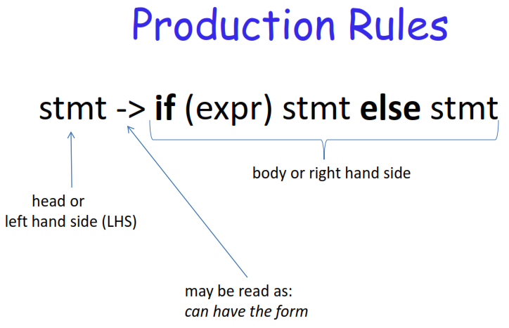

Slide 18
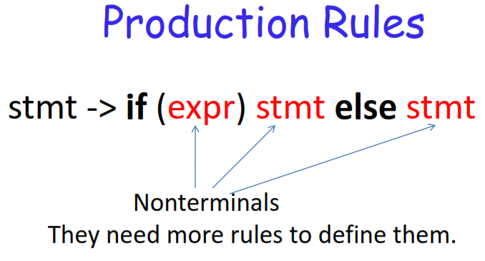

Slide 19
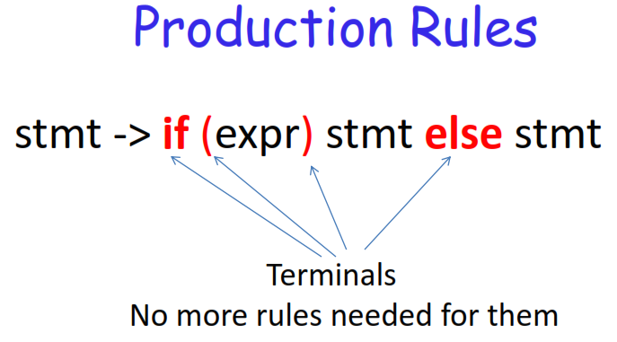

Slide 20
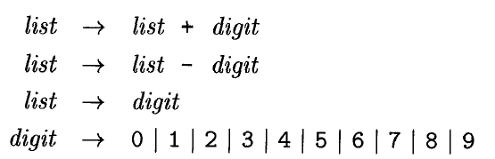
Example
What are the terminals here?
What are the nonterminals?

Slide 21

Example
How to derive: 9-5+7 from the above rules?

Slide 22
Derivations
Let’s do a practice derivation with our grammar. We’ll derive the string “(base1 + base2) * height/2”. The start symbol is expr.
expr expr op expr expr op expr op expr expr op expr op number expr op expr / number expr op id / number expr * id / number ( expr ) * id / number ( expr op expr ) * id / number ( expr op id ) * id / number ( expr + id ) * id / number ( id + id ) * id / number
expr → id | number | - expr | ( expr ) | expr op expr
op → + | - | * | /
Each string of symbols in the steps of the derivation is called a sentential form. The final sentential form is known as the yield.

Slide 23
Parse Trees and Derivations
A parse tree is a graphical representation of a derivation that filters out the order in which productions are applied to replace nonterminals.
The interior node is labeled with the nonterminal A in the head of the production
The leaves of a parse tree are labeled by nonterminals or terminals and, read from left to right, constitute a sentential form, called the yield or frontier of the tree.

Slide 24
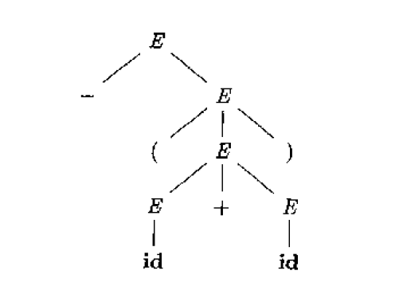
Parse Trees and Derivations
E -> E + E | E * E | - E | ( E ) | id
For example, the parse tree for - (id + id)

Slide 25
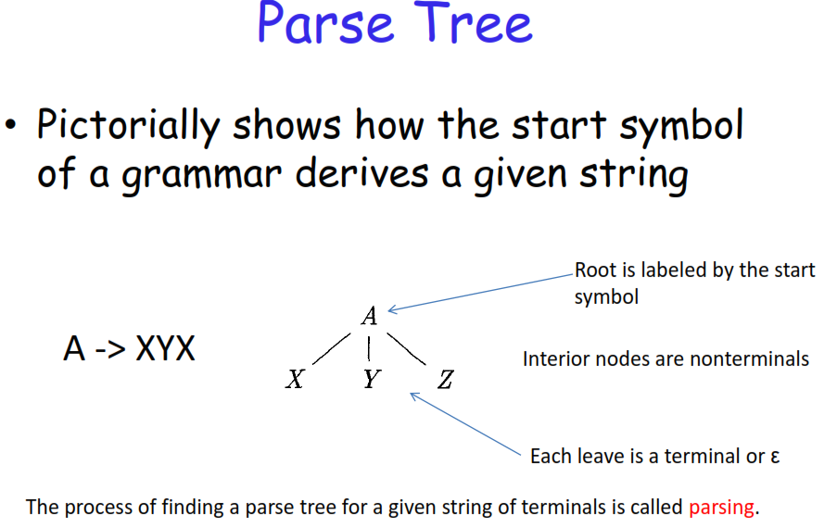

Slide 26
Properties of Parse Tree
Root node of a parse tree is the start symbol of the grammar.
Each leaf node of a parse tree represents a terminal symbol.
Each interior node of a parse tree represents a non-terminal symbol.
Yield Of Parse Tree
Concatenating the leaves of a parse tree from the left produces a string of terminals.
This string of terminals is called as yield of a parse tree

Slide 27
Leftmost, Rightmost Derivations
Definition. A left-most derivation of a sentential form is one in which rules transforming the left-most nonterminal are always applied
Definition. A right-most derivation of a sentential form is one in which rules transforming the right-most nonterminal are always applied

Slide 28
Parse Trees
S → A | A B
A → ε | a | A b | A A
B → b | b c | B c | b B
Sample derivations:
S ⇒ AB ⇒ AAB ⇒ aAB ⇒ aaB ⇒ aabB ⇒ aabb
S ⇒ AB ⇒ AbB ⇒ Abb ⇒ AAbb ⇒ Aabb ⇒ aabb
These two derivations use same productions, but in different orders.
S
Root label = start node.
A
B
Each interior label = variable.
A
A
b
B
Each leaf label = terminal or ε.
a
a
b
All leaf labels together = derived string = yield.

Slide 29
Leftmost & Rightmost Derivations
S → A | A B
A → ε | a | A b | A A
B → b | b c | B c | b B
Sample derivations:
S ⇒ AB ⇒ AAB ⇒ aAB ⇒ aaB ⇒ aabB ⇒ aabb
S ⇒ AB ⇒ AbB ⇒ Abb ⇒ AAbb ⇒ Aabb ⇒ aabb
S
These two derivations are special.
1st derivation is leftmost.
Always picks leftmost variable.
2nd derivation is rightmost.
Always picks rightmost variable.
A
B
A
A
b
B
a
a
b

Slide 30
Derivation Trees
S → A | A B
A → ε | a | A b | A A
B → b | b c | B c | b B
Other derivation trees for this string?
w = aabb
?
S
?
S
S
A
A
B
A
B
A
A
Infinitely many others possible.
A
A
b
B
A
A
b
A
A
A
b
a
a
b
a
A
b
a
ε
A
b
a
a

Slide 31
Ambiguity
A grammar that produces more than one parse tree for some sentence is said to be ambiguous.
Ambiguous grammar is one that produces more than one leftmost derivation or more than one rightmost derivation for the same sentence

Slide 32
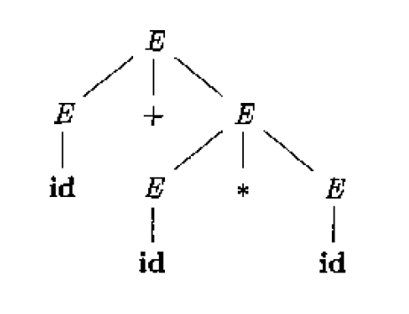
Ambiguity – Example 1
E -> E + E | E * E | - E | ( E ) | id
Two distinct leftmost derivations for the sentence id + id * id
E ⇒ E + E
⇒ id + E
⇒ id + E * E
⇒ id + id * E
⇒ id + id * id

Slide 33
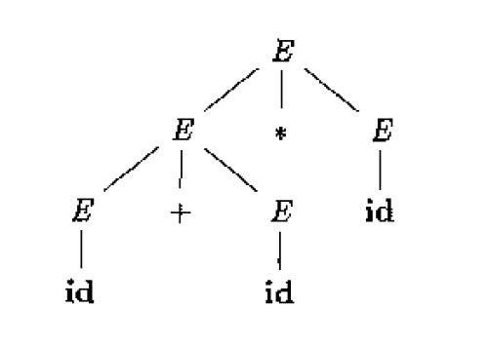
Ambiguity – Example 1
Two distinct leftmost derivations for the sentence id + id * id
E ⇒ E * E
⇒ E + E * E
⇒ id + E * E
⇒ id + id * E
⇒ id + id * id
Since we have more than 1 parse tree therefore grammar is ambiguous

Slide 34
Ambiguity – Example 2
Consider the following: “length * width * height”
From our grammar, we can generate two equally acceptable parse trees.
expr → id | number | - expr | ( expr ) | expr op expr
op → + | - | * | /
expr
expr
expr
op
expr
expr
op
expr
expr
op
expr
*
id
id
*
expr
op
expr
id
*
id
id
*
id

Slide 35
Ambiguity – Example 2
Consider the following: “length * width * height”
From our grammar, we can generate two equally acceptable parse trees.
expr → id | number | - expr | ( expr ) | expr op expr
op → + | - | * | /
expr
expr
expr
op
expr
expr
op
expr
expr
op
expr
*
id
id
*
expr
op
expr
id
*
id
id
*
id
Grammars that allow more than one parse tree for the same string are said to be ambiguous.
Parsers must, in practice, generate special rules for disambiguation.

Slide 36
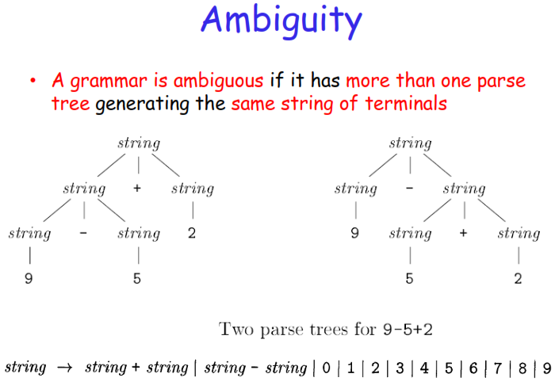

Slide 37
Ambiguity
CFG ambiguous
String with multiple derivation trees.
String with multiple leftmost derivations
String with multiple rightmost derivations

Slide 38
Dealing with Ambiguity - Associativity
CFG ambiguous
E → E - E | id | 5 | 3 | 2
Fails to express that both subtraction and division are left associative.
e.g., 5-3-2 is equivalent to:
((5-3)-2) and not to: (5-(3-2))
Example: two parse trees for the expression 5-3-2 using the grammar given above; one
that correctly groups 5-3, and one that incorrectly groups 3-2

Slide 39
Dealing with Ambiguity - Associativity
To correctly expresses operator associativity:
For left associativity, use left recursion
For right associativity, use right recursion
Here's the correct grammar:
E → E – T | T
T → id | 5 | 3 | 2

Slide 40
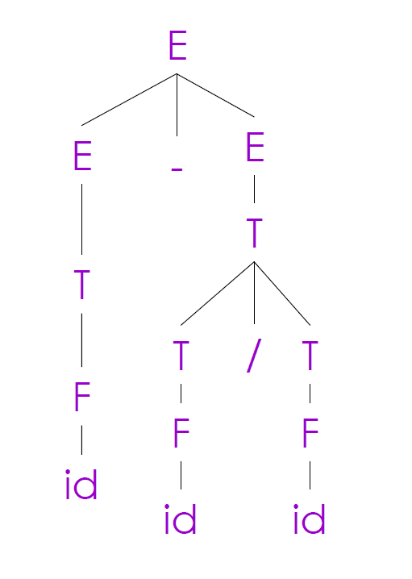
Dealing with Ambiguity - Precedence
id – id / id
Rewrite the grammar
Use a different nonterminal for each precedence level
Start with the lowest precedence (MINUS)
E → E - E | E / E | ( E ) | id
rewrite to
E → E - E | T
T → T / T | F
F → id | ( E )

Slide 41
Dealing with Ambiguity
Previously, we had:
expr → id | number | - expr | ( expr ) | expr op expr
op → + | - | * | /
Building in associativity and operator precedence:
expr → term | expr add_op term term → factor | term mult_op factor factor → id | number | - factor | ( expr ) add_op → + | - mult_op → * | /

Slide 42
Dealing with Ambiguity
Previously, we had:
Example: 3 + 4 * 5
expr → id | number | - expr | ( expr ) | expr op expr
op → + | - | * | /
expr
Building in associativity and operator precedence:
expr
add_op
term
expr → term | expr add_op term term → factor | term mult_op factor factor → id | number | - factor | ( expr ) add_op → + | - mult_op → * | /
term
+
term
mult_op
factor
factor
factor
*
number
number
number

Slide 43
Recursions
Left Recursion
A production of grammar is said to have left recursion if the leftmost variable of its RHS is same as variable of its LHS.
A grammar containing a production having left recursion is called as Left Recursive Grammar.
S → Sa / ∈
Right Recursion
A production of grammar is said to have right recursion if the rightmost variable of its RHS is same as variable of its LHS.
A grammar containing a production having right recursion is called as Right Recursive Grammar.
S → aS / ∈
General Recursion
The recursion which is neither left recursion nor right recursion is called as general recursion.
S → aSb / ∈

Slide 44
Remove left Recursion
Left recursion often poses problems for parsers
It is possible to eliminate left recursion by transformation to right recursion
For a left-recursive pair of rules:
A → Aα | β
Replace with the following rules:
A → βA’
A’ → αA’ | ε

Slide 45
Remove left Recursion – Example 1
Consider the following grammar and eliminate left recursion-
S → S0S1S / 01
Solution-
The grammar after eliminating left recursion is-
S → 01S’
A → 0S1SS’ / ∈

Slide 46
Remove left Recursion – Example 2
Consider the following grammar and eliminate left recursion-
E → E + T / T
T → T x F / F
F → id
Solution-
The grammar after eliminating left recursion is-
E → TE’
E’ → +TE’ / ∈
T → FT’
T’ → xFT’ / ∈
F → id

Slide 47
Remove left Recursion – Example 3
Consider the following grammar and eliminate left recursion-
A → ABd / Aa / a
B → Be / b
Solution-
The grammar after eliminating left recursion is-
A → aA’
A’ → BdA’ / aA’ / ∈
B → bB’
B’ → eB’ / ∈

Slide 48
Remove left Recursion – Example 4
Consider the following grammar and eliminate left recursion-
S → A
A → Ad / Ae / aB / ac
B → bBc / f
Solution-
The grammar after eliminating left recursion is-
S → A
A → aBA’ / acA’
A’ → dA’ / eA’ / ∈
B → bBc / f

Slide 49
Types of Parsers
Parser is mainly classified into 2 categories:
Top-down Parser
Bottom-up Parser.

Slide 50
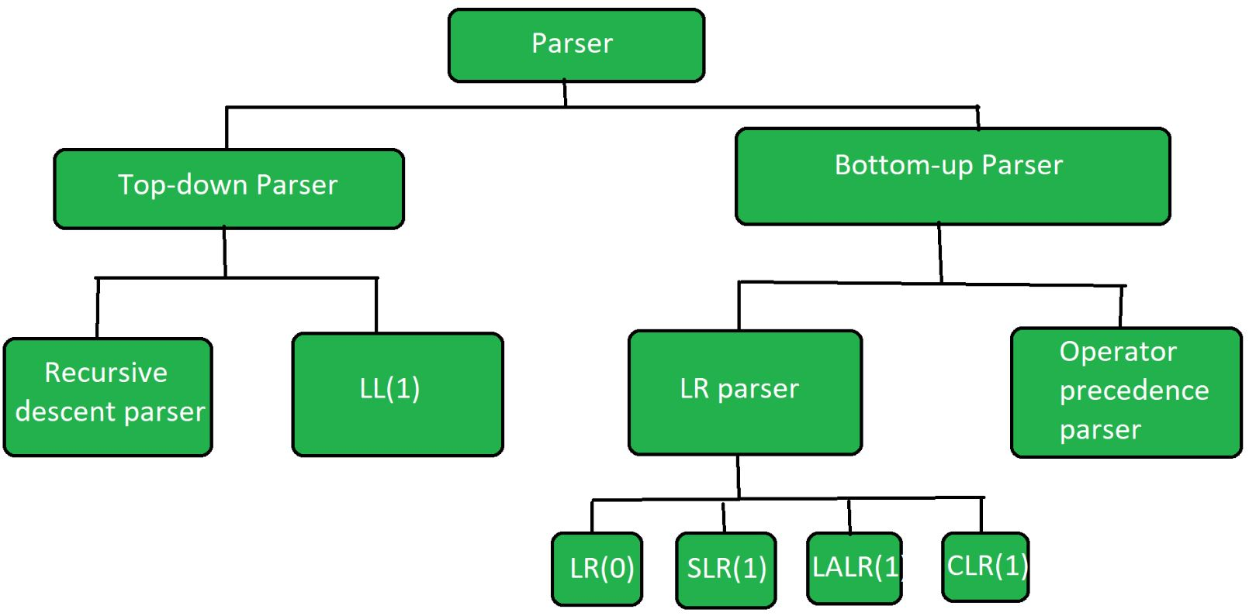

Slide 51
Top Down Parser
Top down Parser
Top-down parser is the parser which generates parse for the given input string with the help of grammar productions by expanding the non-terminals i.e. it starts from the start symbol and ends on the terminals.
It uses left most derivation.
Further Top-down parser is classified into 2 types:
Recursive descent parser
Non-recursive Predictive parser (LL(1))

Slide 52
Top Down Parser
The sequence of parse trees for the input
id + id * id
is a top-down parse according to grammar, repeated here:
E → T E'
E' → + T E’ | ∈
T → F T'
T' → * F T' | ∈
F → ( E ) | id
This sequence of trees corresponds to a leftmost derivation

Slide 53
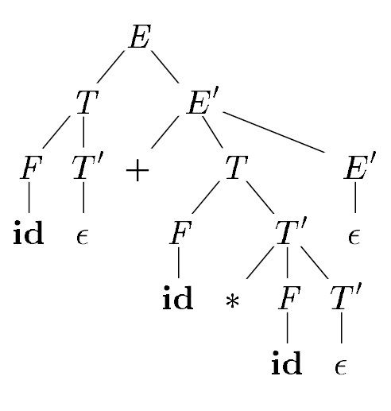
Top Down Parser
Top-down parse for id + id * id

Slide 54
Recursive descent Parser
Recursive descent is a top-down parsing technique that constructs the parse tree from the top and the input is read from left to right.
This parsing technique recursively parses the input to make a parse tree, which may or may not require back-tracking.
Back-tracking
Top- down parsers start from the root node (start symbol) and match the input string against the production rules to replace them (if matched).

Slide 55
Recursive descent Parser
Consider the grammar
S → c A d
A → ab | a
To construct a parse tree top-down for the input string w = cad,
begin with a tree consisting of a single node labeled S, and the input pointer pointing to c, the first symbol of w.
S has only one production, so we use it to expand S and obtain the tree.
The leftmost leaf, labeled c, matches the first symbol of input w, so we advance the input pointer to a, the second symbol of w, and consider the next leaf, labeled A.

Slide 56
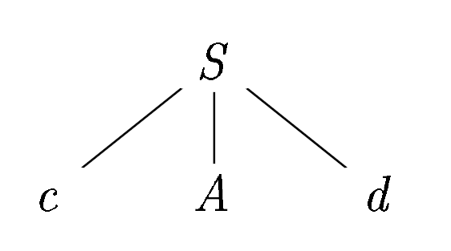
Recursive descent Parser
The leftmost leaf, labeled c, matches the first symbol of input w, so we advance the input pointer to a, the second symbol of w, and consider the next leaf, labeled A.

Slide 57
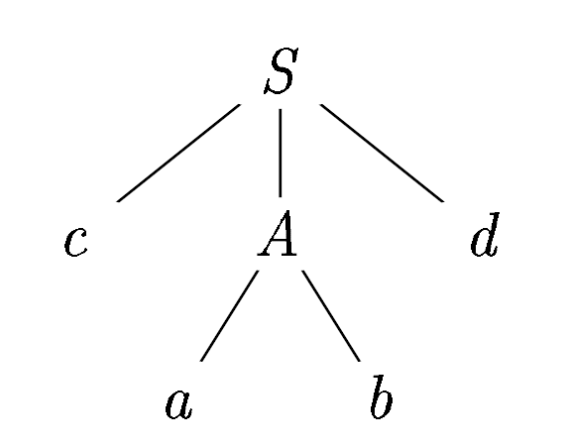
Recursive descent Parser
Now, we expand A using the first alternative A → a b to obtain the tree.
We have a match for the second input symbol, a, so we advance the input pointer to d, the third input symbol, and compare d against the next leaf, labeled b.
Since b does not match d, we report failure and go
back to A to see whether there is another alternative
for A that has not been tried, but that might produce
a match.

Slide 58
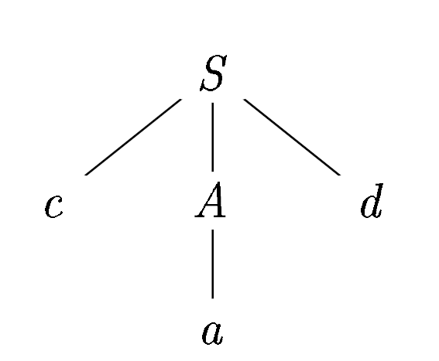
Recursive descent Parser
The second alternative for A produces the tree. The leaf a matches the second symbol of w and the leaf d matches the third symbol.
Since we have produced a parse tree for w, we halt and announce successful completion of parsing.

Slide 59
Recursive descent Parser
Class Activity
A → abC | aBd | aAD
B → bB | ∈
C → d | ∈
D → a | b / ∈
Input string w = aaba

Slide 60
FIRST and FOLLOW
The construction of both top-down and bottom-up parsers is aided by two functions, FIRST and FOLLOW
An important part of parser table construction is to create first and follow sets. These sets can provide the actual position of any terminal in the derivation.

Slide 61
FIRST Set
This set is created to know what terminal symbol is derived in the first position by a non-terminal. For example,
α → t β
That is α derives t (terminal) in the very first position. So FIRST(α) = {t}.
Consider the production rule-
A → abc / def / ghi
Then, we have-
First(A) = { a , d , g }

Slide 62
FOLLOW Set
Define FOLLOW(A) for nonterminal A, to be the set of terminals a that can appear immediately to the right of A.
S → Aab
FOLLOW(A) = ab
1: For the start symbol S, place $ in Follow(S).
2: For any production rule A → αB,
Follow(B) = Follow(A)

Slide 63
FIRST and FOLLOW – Example 1
Problem-01:
Calculate the first and follow functions for the given grammar-
S → aBDh
B → cC
C → bC | ∈
D → EF
E → g | ∈
F → f | ∈

Slide 64
FIRST and FOLLOW – Example 1
Solution-01:
First Functions-
First(S) = { a }
First(B) = { c }
First(C) = { b , ∈ }
First(D) = { g , f , ∈ }
First(E) = { g , ∈ }
First(F) = { f , ∈ }
Follow Functions-
Follow(S) = { $ }
Follow(B) = { g , f , h }
Follow(C) = { g , f , h }
Follow(D) = First(h) = { h }
Follow(E) = { f , h }
Follow(F) = Follow(D) = { h }

Slide 65
FIRST and FOLLOW – Example 2
Problem-02:
Calculate the first and follow functions for the given grammar-
S → Bb | Cd
B → a B | ∈
C → c C | ∈

Slide 66
FIRST and FOLLOW – Example 2
Solution-02:
First Functions-
First(S) = { a, b, c, d }
First(B) = { a , ∈ }
First(C) = { c , ∈ }
Follow Functions-
Follow(S) = { $ }
Follow(B) = { b }
Follow(C) = { d }

Slide 67
FIRST and FOLLOW – Example 3
Problem-03:
Calculate the first and follow functions for the given grammar-
S → ABCDE
A → a | ∈
B → b | ∈
C → c
D → d | ∈
E → e | ∈

Slide 68
FIRST and FOLLOW – Example 3
Solution-03:
First Functions-
First(S) = { a, b, c }
First(A) = { a , ∈ }
First(B) = { b , ∈ }
First(C) = { c }
First(D) = { d , ∈ }
First(E) = { e , ∈ }
Follow Functions-
Follow(S) = { $ }
Follow(A) = { b , c }
Follow(B) = { c }
Follow(C) = { d , e, $ }
Follow(D) = { e , $ }
Follow(E) = { $ }

Slide 69
FIRST and FOLLOW – Example 4
Problem-04:
Calculate the first and follow functions for the given grammar-
E → E + T | T
T → T x F | F
F → (E) | id

Slide 70
FIRST and FOLLOW – Example 4
Solution-04:
The given grammar is left recursive. So, we first remove left recursion from the given grammar.
After eliminating left recursion, we get the following grammar-
E → TE’
E’ → + TE’ | ∈
T → FT’
T’ → x FT’ | ∈
F → (E) | id
Now, the first and follow functions are as follows-

Slide 71
FIRST and FOLLOW – Example 4
Solution-04:
First Functions-
First(E) = First(T) = First(F) = { ( , id }
First(E’) = { + , ∈ }
First(T) = First(F) = { ( , id }
First(T’) = { x , ∈ }
First(F) = { ( , id }
Follow Functions-
Follow(E) = { $ , ) }
Follow(E’) = Follow(E) = { $ , ) }
Follow(T) = { First(E’) – ∈ } ∪ Follow(E) ∪ Follow(E’) = { + , $ , ) }
Follow(T’) = Follow(T) = { + , $ , ) }
Follow(F) = { First(T’) – ∈ } ∪ Follow(T) ∪ Follow(T’) = { x , + , $ , ) }

Slide 72
FIRST and FOLLOW – Example 5
Problem-05:
Calculate the first and follow functions for the given grammar-
S → A
A → aB | Ad
B → b
C → g

Slide 73
FIRST and FOLLOW – Example 5
Solution-05:
The given grammar is left recursive. So, we first remove left recursion from the given grammar.
After eliminating left recursion, we get the following grammar-
S → A
A → aBA’
A’ → dA’ | ∈
B → b
C → g
Now, the first and follow functions are as follows-

Slide 74
FIRST and FOLLOW – Example 5
Solution-05:
First Functions-
First(S) = First(A) = { a }
First(A) = { a }
First(A’) = { d , ∈ }
First(B) = { b }
First(C) = { g }
Follow Functions-
Follow(S) = { $ }
Follow(A) = Follow(S) = { $ }
Follow(A’) = Follow(A) = { $ }
Follow(B) = { First(A’) – ∈ } ∪ Follow(A) = { d , $ }
Follow(C) = NILL

Slide 75
Non-recursive Predictive Parser Construction of LL(1) Parsing Table
We are going to discuss Non-Recursive Descent which is also known as LL(1) Parser.
LL(1) Parsing:
Here the 1st L represents that the scanning of the Input will be done from Left to Right manner and
The second L shows that in this parsing technique we are going to use Left most Derivation Tree.
Finally, the 1 represents the number of look-ahead, which means how many symbols are you going to see when you want to make a decision

Slide 76
Non-recursive Predictive Parser Algorithm to Construction of LL(1) Parsing Table
Step 1: First check for left recursion in the grammar, if there is left recursion in the grammar remove that and go to step 2.
Step 2: Calculate First() and Follow() for all non-terminals.
First(): If there is a variable, and from that variable, if we try to drive all the strings then the beginning Terminal Symbol is called the First.
Follow(): What is the Terminal Symbol which follows a variable in the process of derivation.

Slide 77
Non-recursive Predictive Parser Algorithm to Construction of LL(1) Parsing Table
Step 3: For each production A –> α. (A tends to alpha)
Find First(α) and for each terminal in First(α), make entry A –> α in the table.
If First(α) contains ε (epsilon) as terminal than, find the Follow(A) and for each terminal in Follow(A), make entry A –> α in the table.
If the First(α) contains ε and Follow(A) contains $ as terminal, then make entry A –> α in the table for the $.

Slide 78
Construction LL(1) Parsing Table – Example 1
E --> TE’
E' --> +TE' | ε
T --> FT’
T' --> *FT' | ε
F --> id | (E)
*ε denotes epsilon

Slide 79
Construction LL(1) Parsing Table – Example 1
 | First | Follow
E –> TE’ | { id, ( } | { $, ) }
E’ –> +TE’ |ε | { +, ε } | { $, ) }
T –> FT’ | { id, ( } | { +, $, ) }
T’ –> *FT’ |ε | { *, ε } | { +, $, ) }
F –> id| (E) | { id, ( } | { *, +, $, ) }

Slide 80
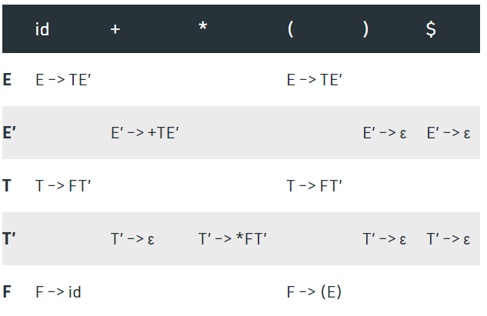
Construction LL(1) Parsing Table – Example 1

Slide 81
Construction LL(1) Parsing Table – Example 2
S--> (L) | a
L --> S L'
L' --> ε | ,SL'

Slide 82
Construction LL(1) Parsing Table – Example 2
 | First | Follow
S--> (L) | a | { (, a } | { $, ) }
L --> S L' | { (, a } | { ) }
L' --> ε | ,SL' | { , , ε } | { ) }

Slide 83
Construction LL(1) Parsing Table – Example 2
 | ( | a | , | ) | $
S--> (L) | a | S--> (L) | S--> a
L --> S L' | L --> S L' | L --> S L'
L' --> ε | ,SL' |  |  | L' --> ,SL' | L' --> ε

Slide 84
Construction LL(1) Parsing Table – Example 3
E --> TX
X --> +E | ε
T --> (E) | int Y
Y --> *T | ε

Slide 85
Construction LL(1) Parsing Table – Example 3
 | First | Follow
E --> TX | { (, int } | { $, ) }
X --> +E | ε | { +, ε } | {$, ) }
T --> (E) | int Y | {(, int } | { +, $, ) }
Y --> *T | ε | {*, ε} | {+, $, )}

Slide 86
Construction LL(1) Parsing Table – Example 3
 | ( | int | + | * | ) | $
E --> TX | E --> TX | E --> TX
X --> +E | ε |  |  | X --> +E |  | X --> ε | X --> ε
T --> (E) | int Y | T --> (E) | T --> int Y
Y --> *T | ε |  |  | Y --> ε | Y --> *T | Y --> ε | Y --> ε

Slide 87
Note
Every grammar is not feasible for LL(1) Parsing table. It may be possible that one cell may contain more than one production.

Slide 88
Construction LL(1) Parsing Table – Example 1
S --> A | a
A --> a

Slide 89
Construction LL(1) Parsing Table – Example 1
 | First | Follow
S –> A|a | { a } | { $ }
A –>a | { a } | { $ }

Slide 90
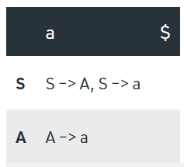
Construction LL(1) Parsing Table – Example 1

Slide 91
Construction LL(1) Parsing Table – Example 2
S --> aSbS|bSaS | ε

Slide 92
Construction LL(1) Parsing Table – Example 2
 | First | Follow
S --> aSbS|bSaS | ε | { a, b, ε} | { $,a, b}

Slide 93
Construction LL(1) Parsing Table – Example 2
 | a | b | $
S --> aSbS|bSaS | ε | S --> aSbS S --> ε | S --> bSaS S --> ε | S --> ε

Slide 94
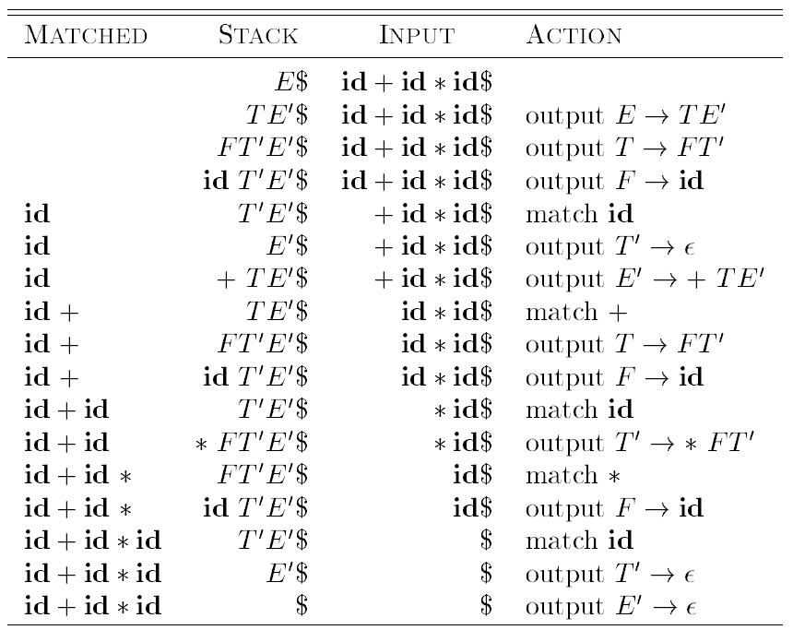
Non-recursive Predictive Parser Tree
Predictive parser on input
id + id * id

Slide 95
Non-recursive Predictive Parser Tree
Predictive parser on input
id + id * id

Slide 97
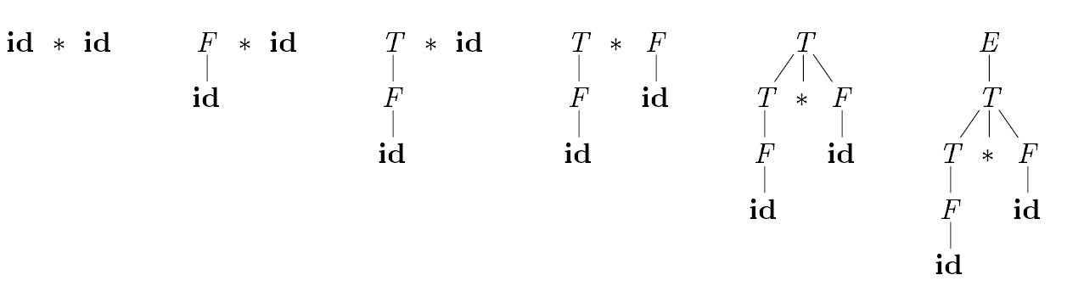
Bottom up Parser
A bottom-up parse corresponds to the construction of a parse tree for an input string beginning at the leaves (the bottom) and working up towards the root (the top).
A bottom-up parse of the token stream id * id, with respect to the expression grammar. E → E + T | T T → T x F | F F → id

Slide 98
Handle Pruning
Bottom-up parsing during a left-to-right scan of the input constructs a rightmost derivation in reverse.
Informally, a "handle" is a substring that matches the body of a production, and whose reduction represents one step along the reverse of a rightmost derivation.

Slide 99
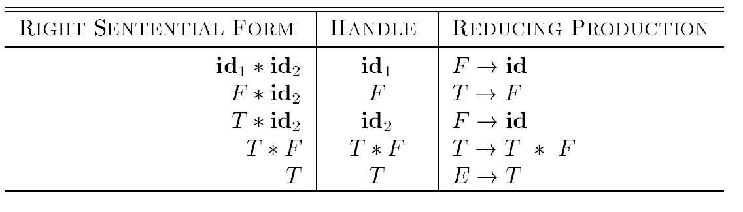
Handle Pruning
Handles during a parse of id_{l} * id₂
Expression grammar.
E → E + T | T
T → T x F | F
F → id

Slide 100
Handle Pruning
Example of Handle pruning
Consider the following CFG
D →TL;
T → int
T → float
T → char
L→ L,id
L → id
The parsing table for the input string int id,id;

Slide 101
Handle Pruning
Input String | Handle | Action
Int id,id; | int | Reduce T→int
T id,id; | Id | Reduce L→id
T L,id; | L, id | Reduce L→L,id
TL; | TL; | Reduce D→TL
D | - | Accepted

Slide 102
Shift-Reduce Parsing
Shift-reduce parsing is a form of bottom-up parsing in which a stack holds grammar symbols and an input buffer holds the rest of the string to be parsed.
We use $ to mark the bottom of the stack and also the right end of the input.
When discussing bottom-up parsing, we show the top of the stack on the right, rather than on the left as we did for top-down parsing.

Slide 103
Shift-Reduce Parsing
Primary operations are shift and reduce, there are actually four possible actions a shift-reduce parser can make:
(1) shift, (2) reduce, (3) accept, and (4) error.
1. Shift: Shift the next input symbol onto the top of the stack.
2. Reduce: The right end of the string to be reduced must be at the top of the stack. Locate the left end of the string within the stack and decide with what nonterminal to replace the string.
3. Accept: Announce successful completion of parsing.
4. Error: Discover a syntax error and call an error recovery routine.

Slide 104
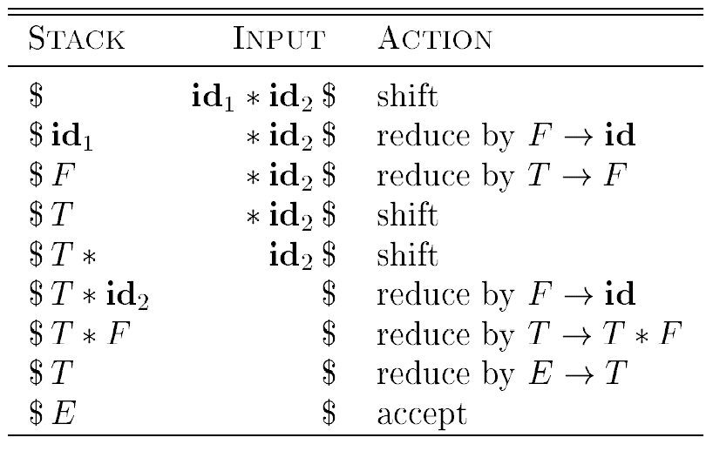
Shift-Reduce Parsing
Example 1: Input string id₁ *id₂ according to the expression grammar
E → E + T | T
T → T x F | F
F → id

Slide 105
Shift-Reduce Parsing
Example 2: Consider the grammar S –> S + S S –> S * S S –> id
Perform Shift Reduce parsing for input string
id + id + id

Slide 106
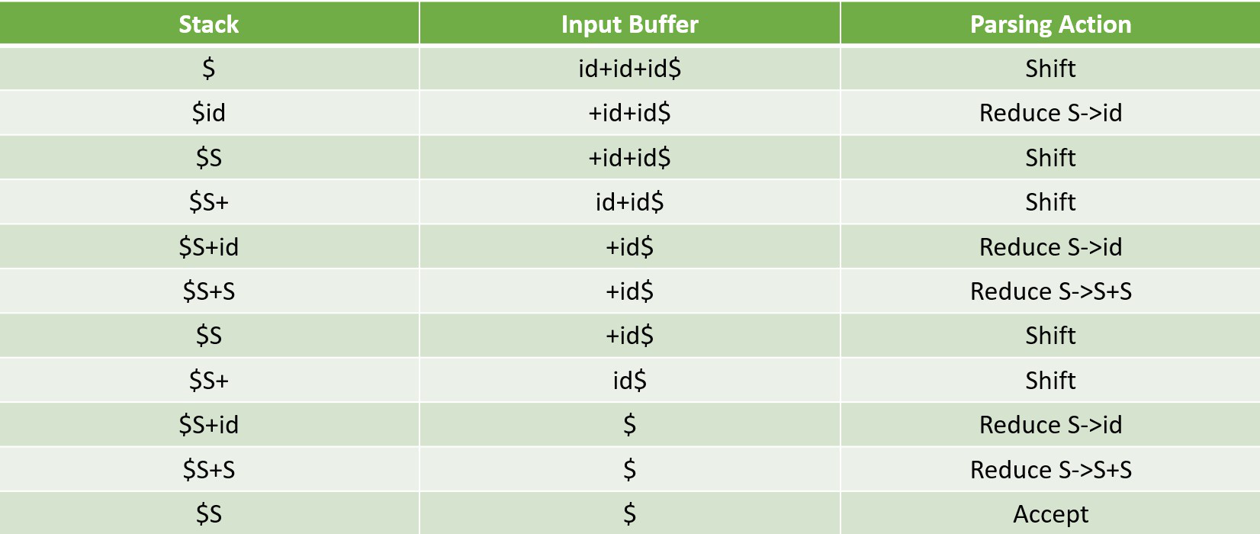
Shift-Reduce Parsing

Slide 107
Shift-Reduce Parsing
Example 3: Consider the grammar E –> 2E2 E –> 3E3 E –> 4 Perform Shift Reduce parsing for input string “32423”

Slide 108
Shift-Reduce Parsing

Slide 109
LR(0) Parsing
LR parsers are table-driven, much like the non-recursive LL(1) parsers
This technique is also called LR(0) parsing. L stands for left to right scanning R stands for rightmost derivation in reverse 0 stands for no. of input symbols of lookahead.

Slide 110
LR(0) items
An LR(0) item (item for short) of a grammar G is a production of G with a dot at some position of the body. Thus, production A → XYZ yields the four items.
A → .XYZ
A → X.YZ
A → XY.Z
A → XYZ.

Slide 111
Augmented grammar
If P is a grammar with starting symbol S, then G’ (augmented grammar for G) is a grammar with a new starting symbol S‘ and productions S‘ -> .S
The purpose of this new starting production is to indicate the parser when it should stop parsing.

Slide 112
Example 1 – Construction of LR(0) Parsing Table
Construct a LR(0) parsing table for the given context free grammar –
S → AA
A → aA|b

Slide 113
Solution – Construction of LR(0) Parsing Table
STEP 1- Find augmented grammar
The augmented grammar of the given grammar is:-
S’ → .S [0th production] S → .AA [1st production] A → .aA [2nd production] A → .b [3rd production]

Slide 114
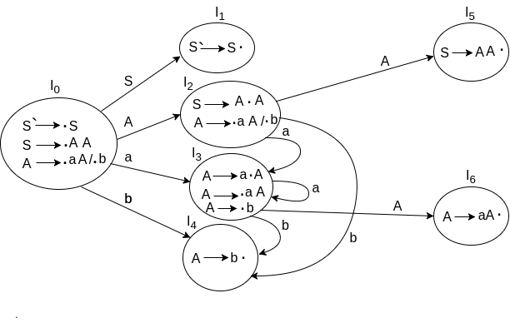
Solution – Construction of LR(0) Parsing Table
STEP 2- Find LR(0) collection of items

Slide 115
Solution – Construction of LR(0) Parsing Table
STEP3 – defining 2 functions:
Goto [list of non terminals] and action [list of terminals] in the parsing table
If a state is going to some other state on a terminal then it correspond to a shift move.
If a state is going to some other state on a variable then it correspond to go to move.
If a state contain the final item in the particular row then write the reduce node completely.

Slide 116
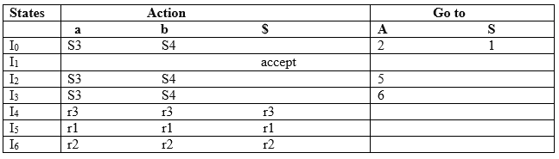
Solution – Construction of LR(0) Parsing Table

Slide 117
Example 2 – Construction of LR(0) Parsing Table
Construct a LR(0) parsing table for the given context free grammar –
S → (S)
S → id

Slide 118
Solution – Construction of LR(0) Parsing Table
STEP 1- Find augmented grammar –
The augmented grammar of the given grammar is:-
S’ → .S [0th production] S → .(S) [1st production] S → .id [2nd production]

Slide 119
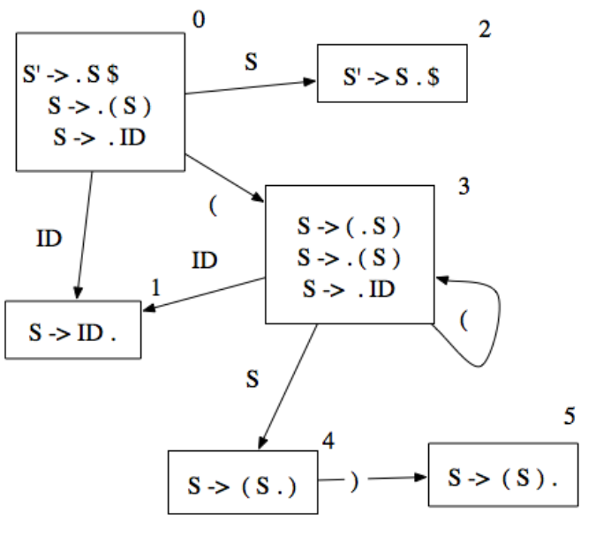
Solution – Construction of LR(0) Parsing Table
STEP 2- Find LR(0) collection of items

Slide 120
Solution – Construction of LR(0) Parsing Table
STEP3 – defining 2 functions:
Goto [list of non terminals] and action [list of terminals] in the parsing table
If a state is going to some other state on a terminal then it correspond to a shift move.
If a state is going to some other state on a variable then it correspond to go to move.
If a state contain the final item in the particular row then write the reduce node completely.

Slide 121
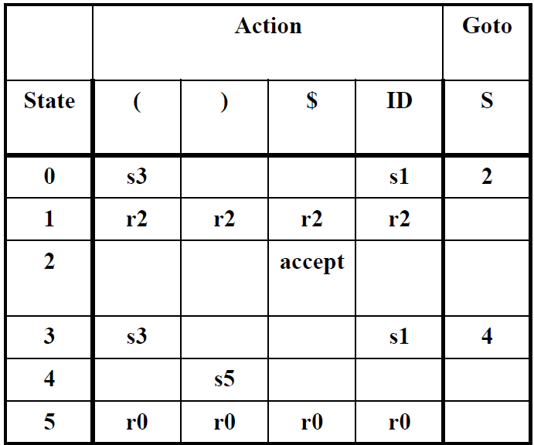
Solution – Construction of LR(0) Parsing Table

Slide 122
Example 03 – Construction of LR(0) Parsing Table
Consider the augmented expression grammar:-
E’ → .E
E → .E + T | .T
T → .T * F | .F
F → .(E) I .id

Slide 123
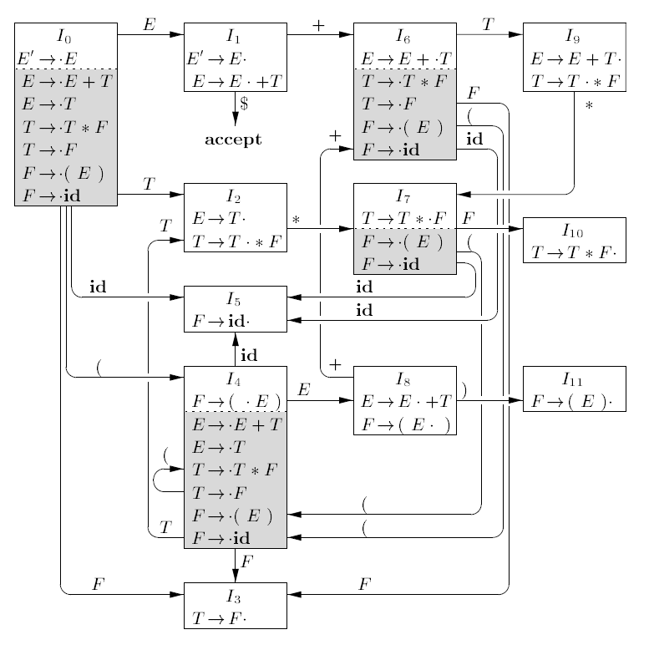
Solution – Construction of LR(0) Parsing Table
STEP 1- Find LR(0) collection of items

Slide 124
Solution – Construction of LR(0) Parsing Table
STEP2 – defining 2 functions:
Goto [list of non terminals] and action [list of terminals] in the parsing table
If a state is going to some other state on a terminal then it correspond to a shift move.
If a state is going to some other state on a variable then it correspond to go to move.
If a state contain the final item in the particular row then write the reduce node completely.

Slide 125
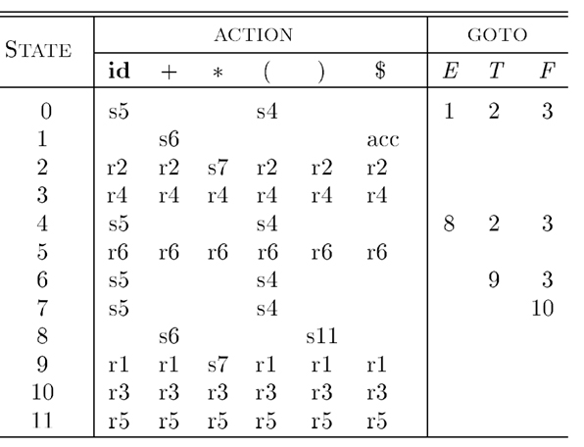
Solution – Construction of LR(0) Parsing Table

Slide 126
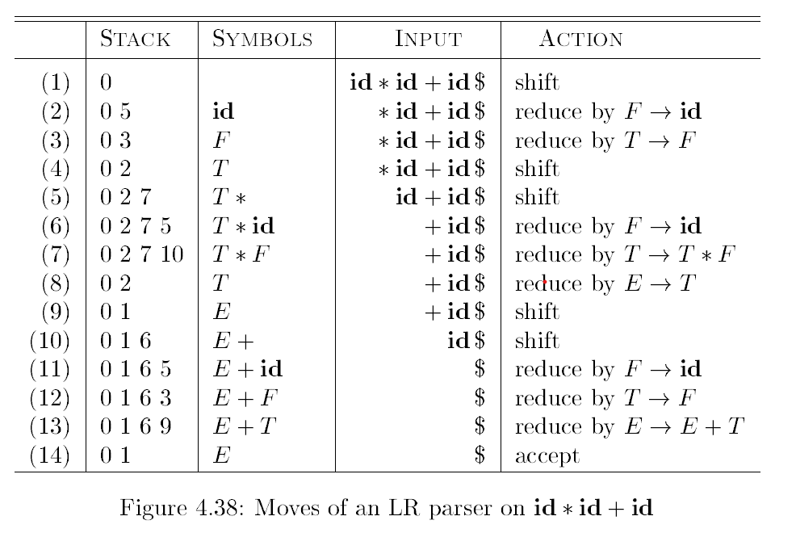
Solution – Construction of LR(0) Parsing Table

Slide 127
Difference Between SLR(1) & LR(0) Parsing Table
SLR (1) parsing table construction is same as LR(0).
The only difference is that in reduce state we need to follow of non terminal in left hand side.
E’ → .E
E → .E + T | .T
T → .T * F | .F
F → .(E) I .id

Slide 128
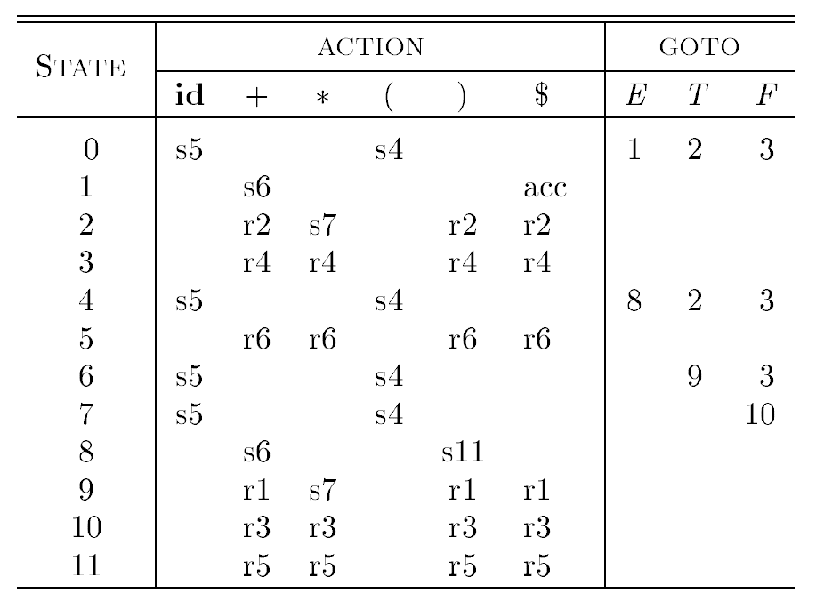
Construction of SLR(1) Parsing Table

Slide 129
CLR/LR(1) Parser
A top-down parser that uses a one-token lookahead is called an LL(1) parser.
The first L indicates that the input is read from left to right.
The second L says that it produces a left-to-right derivation.
And the 1 says that it uses one lookahead token.

Slide 130
Example – Construction of CLR/LR(1) Parsing Table
Consider the augmented expression grammar:-
S’ → .S
S → .CC
C → .cC | .d

Slide 131
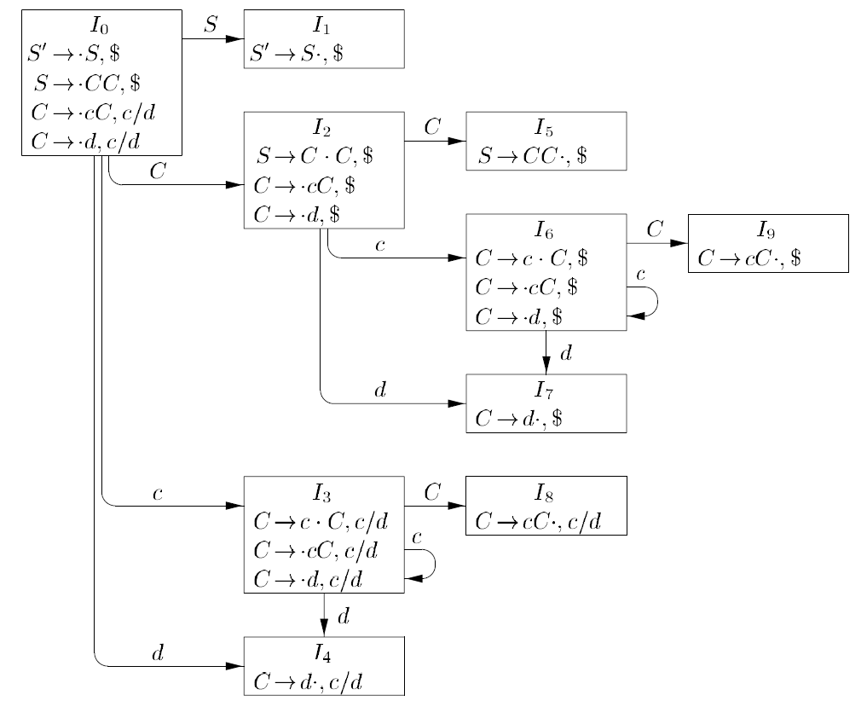
Construction of CLR/LR(1) Parsing Table

Slide 132
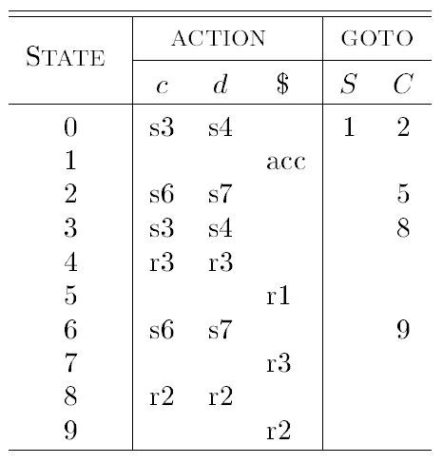
Construction of CLR/LR(1) Parsing Table

Slide 133
LALR (1) Parser
LALR Parser is lookahead LR parser.
The size of CLR parsing table is quite large as compared to other parsing table. LALR reduces the size of this table.

Slide 134
Difference Between CLR(1) & LALR (1) Parsing Table
LALR works similar to CLR.
The only difference is , it combines the similar states of CLR parsing table into one single state.
S’ → .S
S → .CC
C → .cC | .d

Slide 135
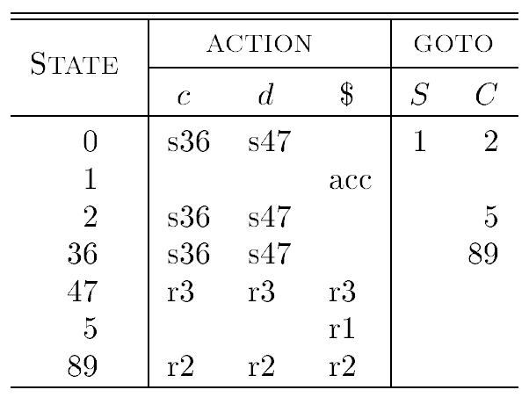
Construction of LALR (1) Parse Table

